Slide 1
Specialized Gardening
Liz Eli
Julie Hong
Whitney White

Slide 2
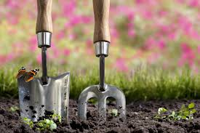
What should I plant?
Choose your preference to create a garden specific for you!
State
Season
Plant Type
Sun Needs
Soil Needs

Slide 3
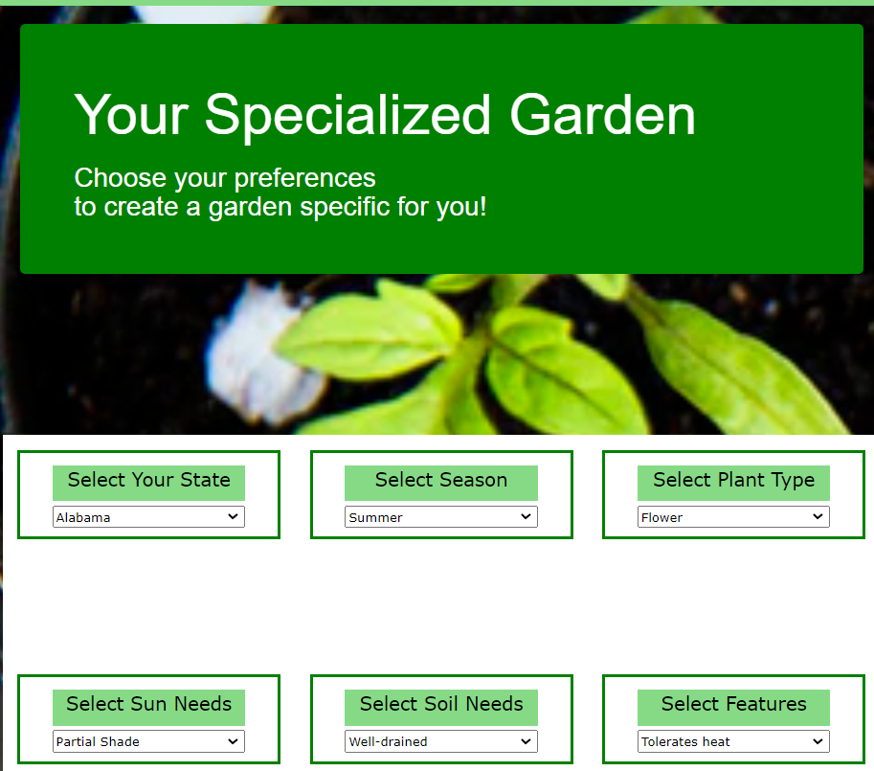
Let’s go see if it works!

Slide 4
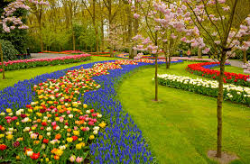
Questions?

